Slide 1
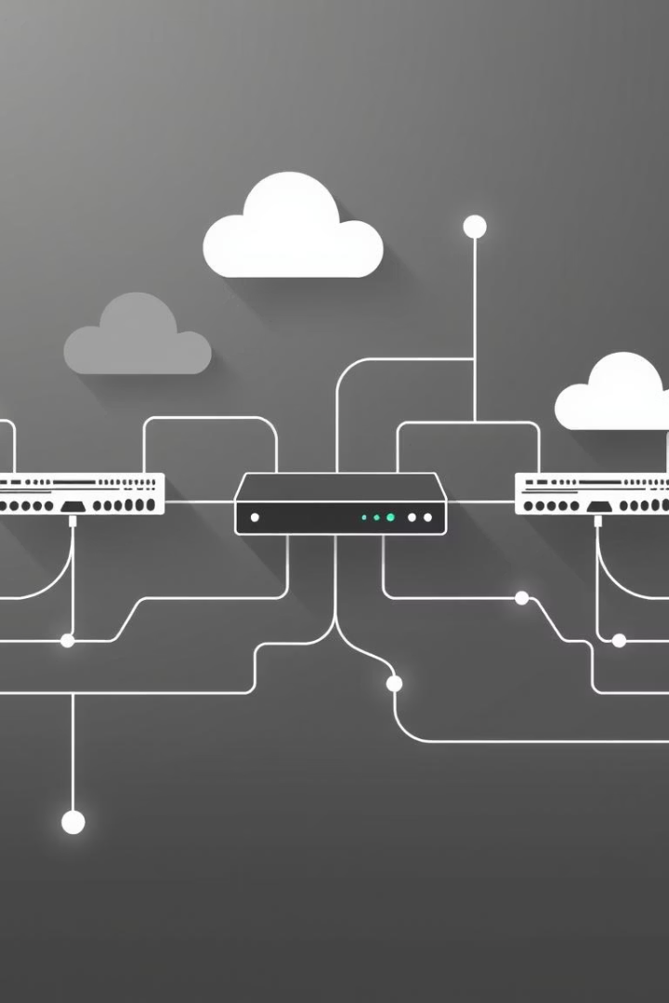
Enterprise Network Project: Single-Site Implementation
Your Name and Team Members
Cisco Network Administrator - Projects

Slide 2
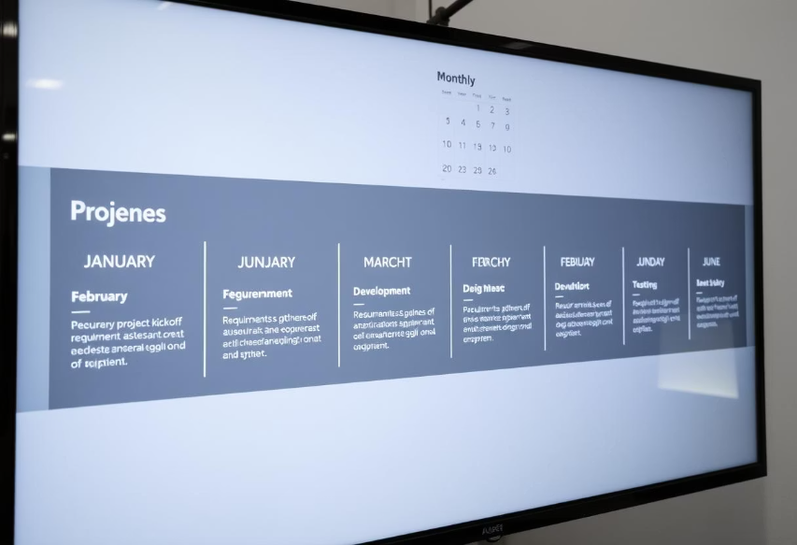
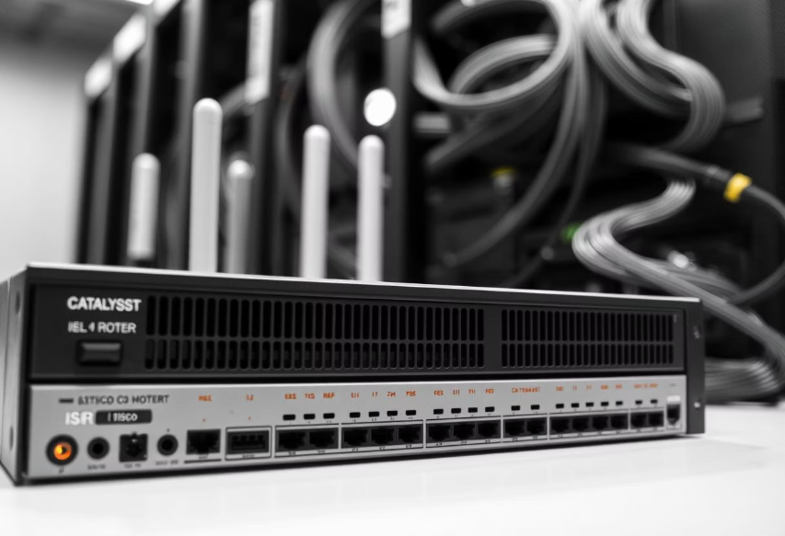
Project Overview
Project Scope & Objectives
Network Components
Design and implement a single-site enterprise network over a 4-week schedule.
3 Cisco ISR 4331 Routers
2 Catalyst 9300 Distribution Switches (DSW)
Network segmentation for improved security
4 Catalyst 2960-X Access Switches (ASW)
Redundancy to ensure high availability
20 Standard Corporate PCs
Robust security measures across the infrastructure
1 Log Server

Slide 3
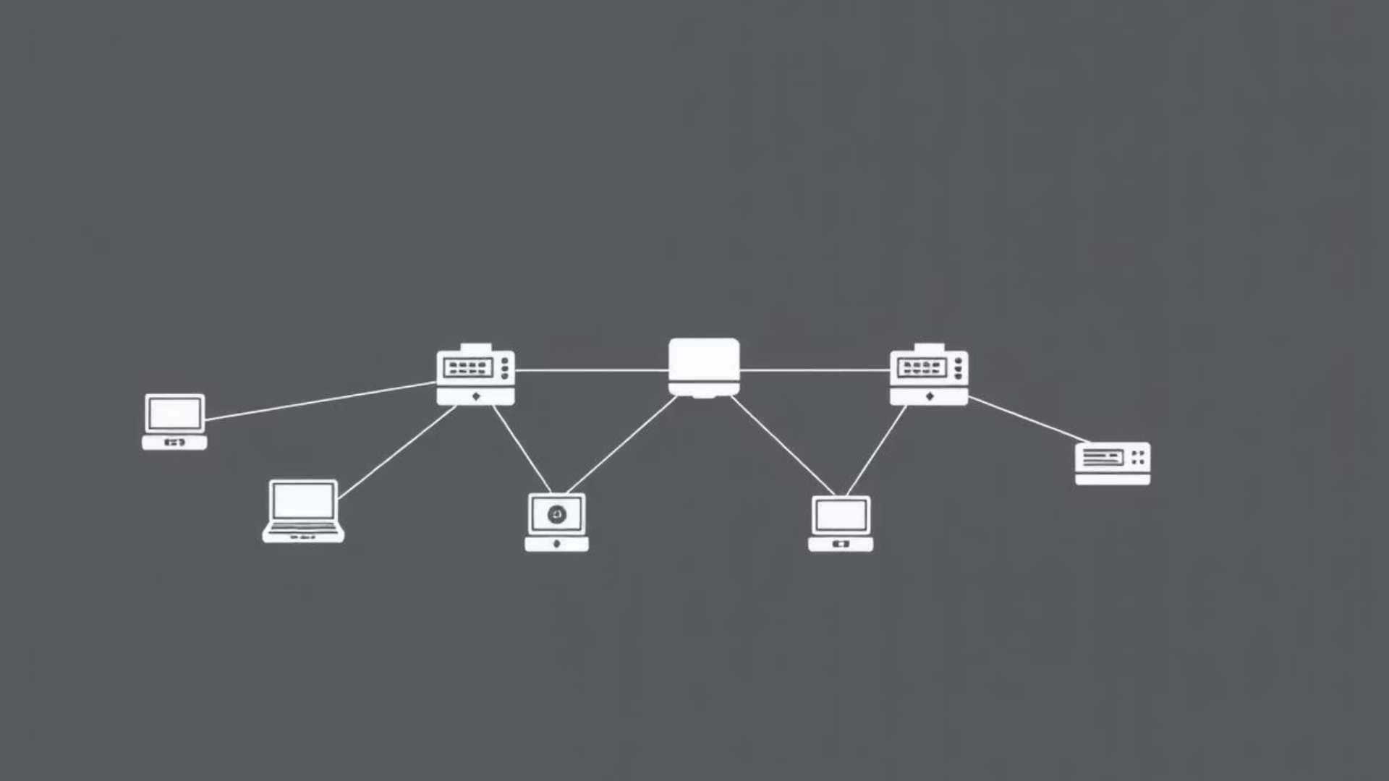
Network Topology
Core Layer
Distribution Layer
Access Layer
3 routers providing connectivity to the ISP and facilitating data transfer between network segments.
2 Layer-3 switches responsible for inter-VLAN routing and enforcing security policies.
4 switches connecting end-user devices with VLAN segmentation for security and organization.
Three-tier hierarchical design ensures scalability, redundancy, and security across the enterprise network.

Slide 4




Building the Internal Network
Traffic Patterns
Analyze communication flows between departments to optimize routing.
Bandwidth Requirements
Ensure sufficient capacity for different applications including critical ones.
Security Zones
Define access controls and separate zones for sensitive data.
Redundancy Needs
Implement failover mechanisms for critical services to maintain uptime.
Implementation Tool: Cisco Packet Tracer for network simulation and testing.

Slide 5
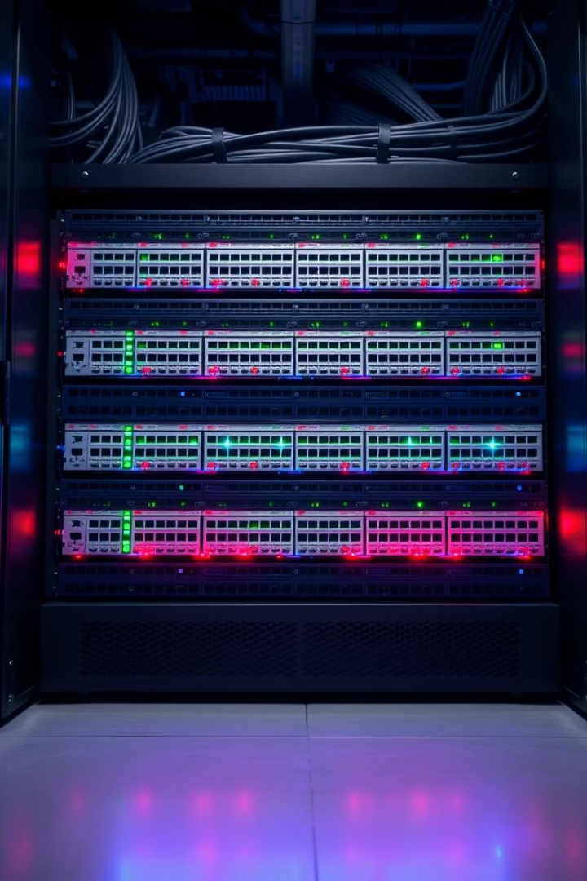

Access and Distribution Switch Configuration
Basic Switch Configurations
Configure hostnames, secure passwords, and customized welcome banners for clear device identification and enhanced security.
Enable password encryption and limit management access to authorized users exclusively.
VLAN Implementation
Establish and label VLANs following organizational standards.
Allocate switch ports strategically based on device functions and security requirements.

Slide 6

Router Configuration
Basic Router Configurations:
Set hostnames, passwords, and welcome banners for identification and security
Enable password encryption and configure secure access methods
Sub-interface Configuration for Inter-VLAN Routing:
Use encapsulation dot1Q for VLAN tagging
Assign IP addresses to each VLAN interface
Configure serial interfaces as required for WAN connectivity

Slide 7
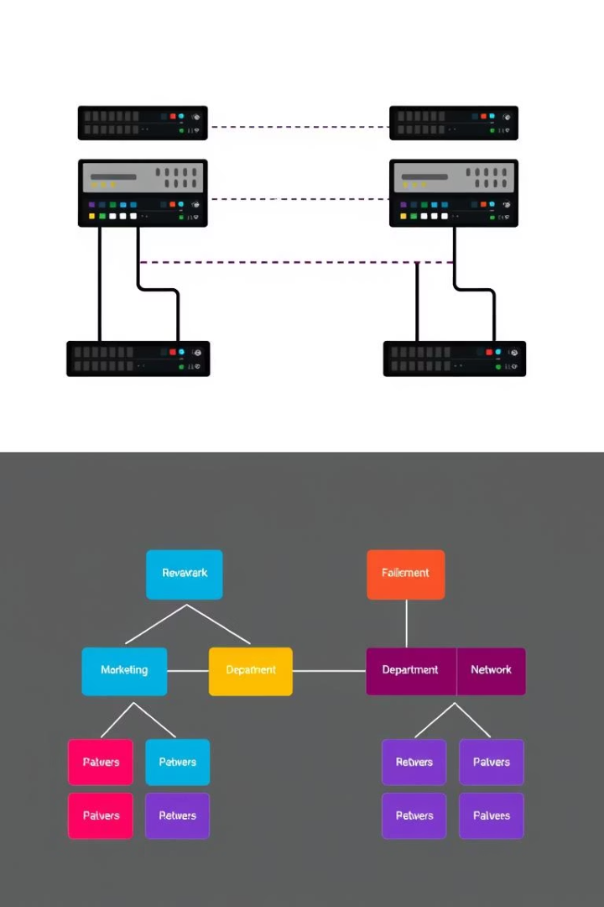
Protocol Justifications
HSRP (Hot Standby Router Protocol):
Provides gateway redundancy with 99.99% uptime
Failover occurs in less than 3 seconds
Transparent to end users during router failures
Reduces business impact during maintenance windows
VLANs (Virtual Local Area Networks):
Enhance network segmentation and security
Reduce broadcast domains and improve performance
Allow logical grouping of devices regardless of physical location
Simplify network management and scalability

Slide 8

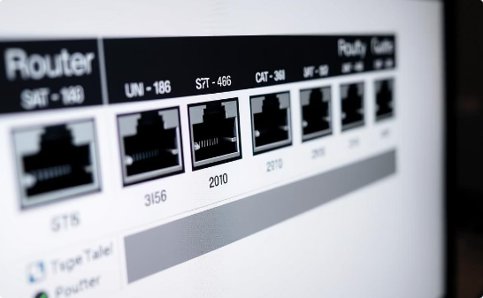
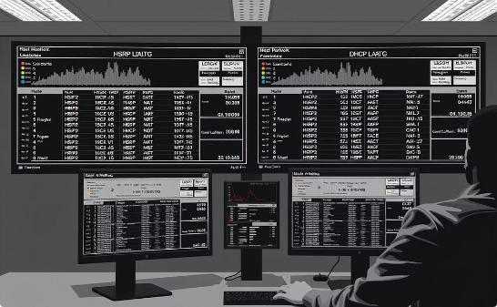
Verification Commands
Switch Commands: show vlan brief, show interfaces trunk, show etherchannel summary
show spanning-tree for STP topology and show port-security interface checks security
Router Commands: show ip interface brief shows interface status
show standby brief verifies HSRP, show ip dhcp binding lists DHCP leases
show access-lists checks ACLs, show logging reviews recent events
Switch Verification
Router Status
Protocol Monitoring

Slide 9


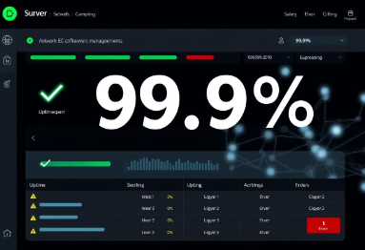

Business Benefits of the Network Implementation
Performance Improvements
Security Enhancements
Reliability & Management
Return on Investment
Downtime savings of ~$5,000 per hour
40% reduction in network latency for critical apps
Departmental isolation limits lateral movement
99.99% uptime via HSRP redundancy
Improved security reduces breach risks
75% decrease in broadcast traffic
Port security blocks unauthorized access
Centralized logging cuts troubleshooting time by 60%
Scalable for 50% growth without major redesign
Optimized paths with explicit STP configuration
ACLs enforce business-driven access policies
DHCP automation prevents manual IP errors

Slide 10

Conclusion and Future Outlook
Project Success: All components implemented on schedule, meeting requirements.
Future Expansion: Wireless integration, multi-site connectivity, IPv6, and enhanced security.
Key Lessons: Importance of planning, testing, and standard configuration templates.
Contact: Reach out for questions or further collaboration.

